Slide 1
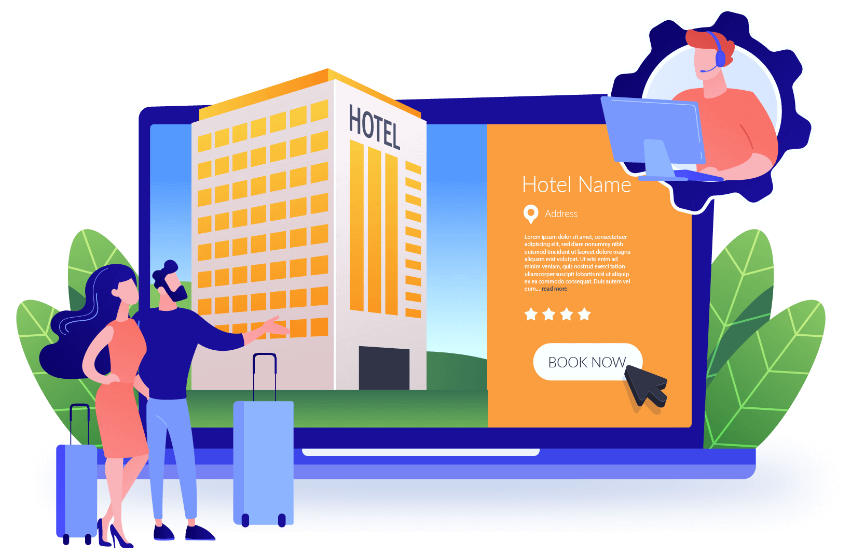
HOTEL MANAGEMENT
HOTEL MANAGEMENT
SYSTEM
200122100685 – (S.E.M Rodrigo)
200058901243 – (W.H.N Fernando)
200163303048 – (M.A.P Buddhima)
- Project Report -

Slide 2
Contents
INTRODUCTION
Introduction
Product Scope
Methodology
User Interfaces
Diagrams
Our project report is for the development of a hotel management system for Rico Shadow Guesthouse and Restaurant, located in Kammala North, Waikkala. Our proposed system aims to modernize the hotel's manual file-based system and provide a more efficient way of managing hotel operations.​

Slide 3

Product Scope
INTRODUCTION
Our project report is for the development of a hotel management system for Rico Shadow Guesthouse and Restaurant, located in Kammala North, Waikkala. Our system will modernize the hotel's manual file-based system and provide a more efficient way of managing hotel operations.​

Slide 4
Product Scope
Our project aims to develop a web-based hotel management system that addresses the challenges of their current manual system. The system will encompass various key functionalities, including room booking and food ordering
Requirements and Analysis
we conducted in-depth discussions with hotel staff, management to gather their input and understand their needs

Slide 5


Our project aims to develop a web-based hotel management system that addresses the challenges of their current manual system. The system will encompass various key functionalities, including room booking and food ordering
Methodology
Requirements and Analysis
we conducted in-depth discussions with hotel staff, management to gather their input and understand their needs
Design
visualize the user interfaces of the room booking module and the kitchen system. Additionally, we designed the database schema to store information

Slide 6
Methodology
Design
visualize the user interfaces of the room booking module and the kitchen system. Additionally, we designed the database schema to store information
Implementation
we transformed the design specifications into a working hotel management system. We developed the backend and frontend components of the room booking and kitchen

Slide 7
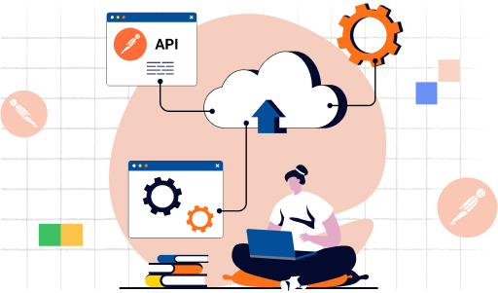
Methodology
Implementation
we transformed the design specifications into a working hotel management system. We developed the backend and frontend components of the room booking and kitchen food ordering
Testing
We conducted a comprehensive test plan to ensure that all aspects of the hotel management system were thoroughly tested. Our test plan included various types of testing.
Unit Testing
Integration Testing
System Testing
User Acceptance Testing
Usability Testing
Security Testing
Error Handling Testing

Slide 8
Methodology
Testing
We conducted a comprehensive test plan to ensure that all aspects of the hotel management system were thoroughly tested. Our test plan included various types of testing.
Unit Testing
Integration Testing
System Testing
User Acceptance Testing
Usability Testing
Security Testing
Error Handling Testing
Performance Testing:

Slide 9
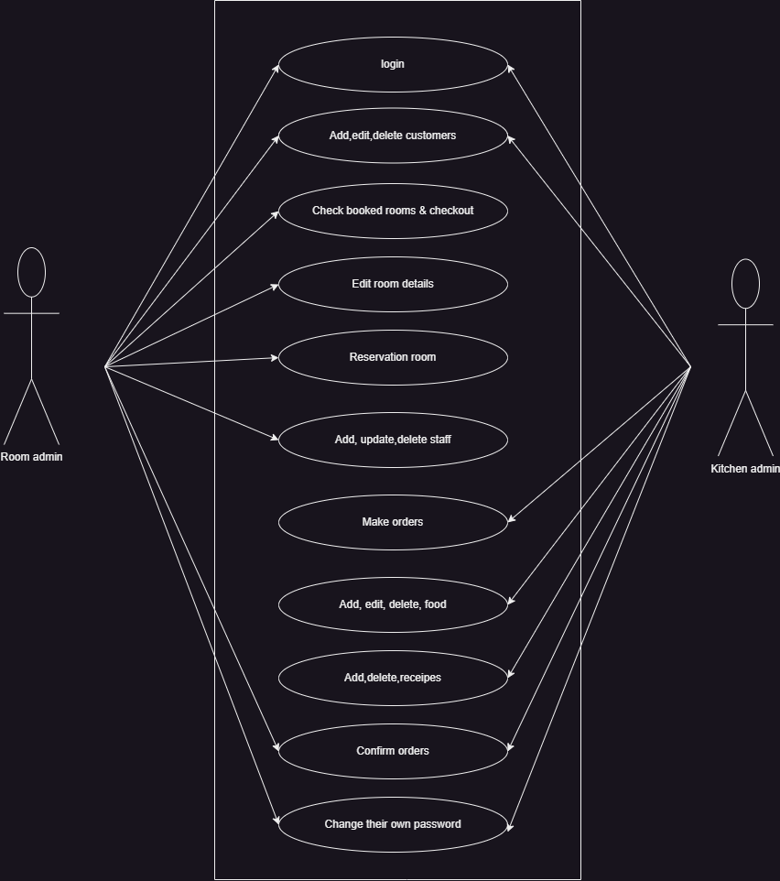
Use Case diagram

Slide 10
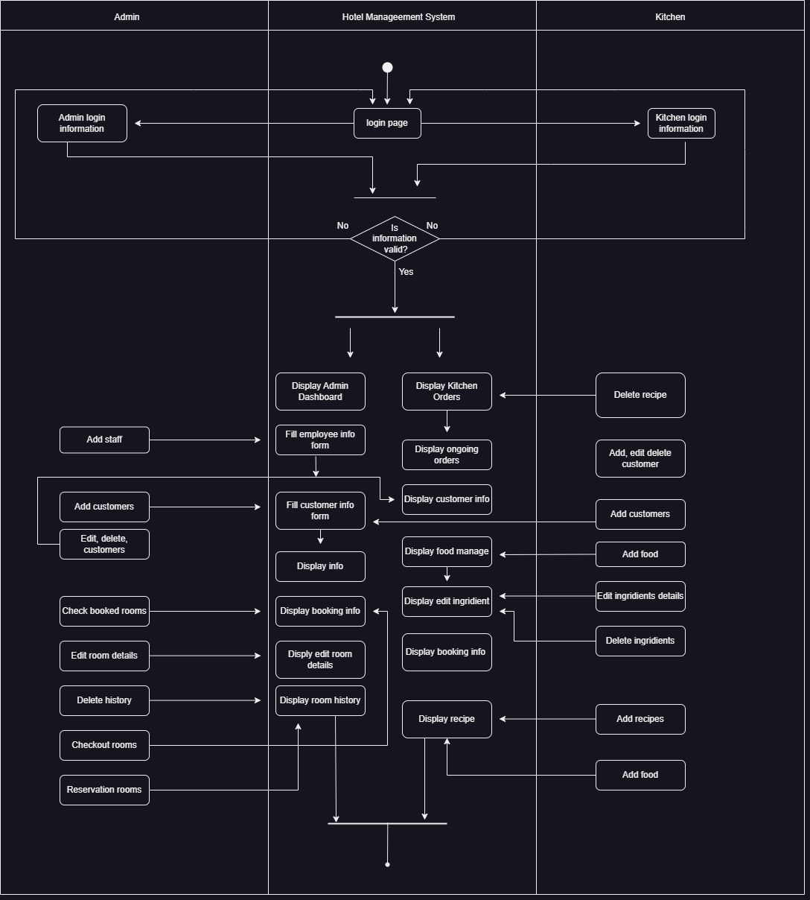
Activity Diagram

Slide 11
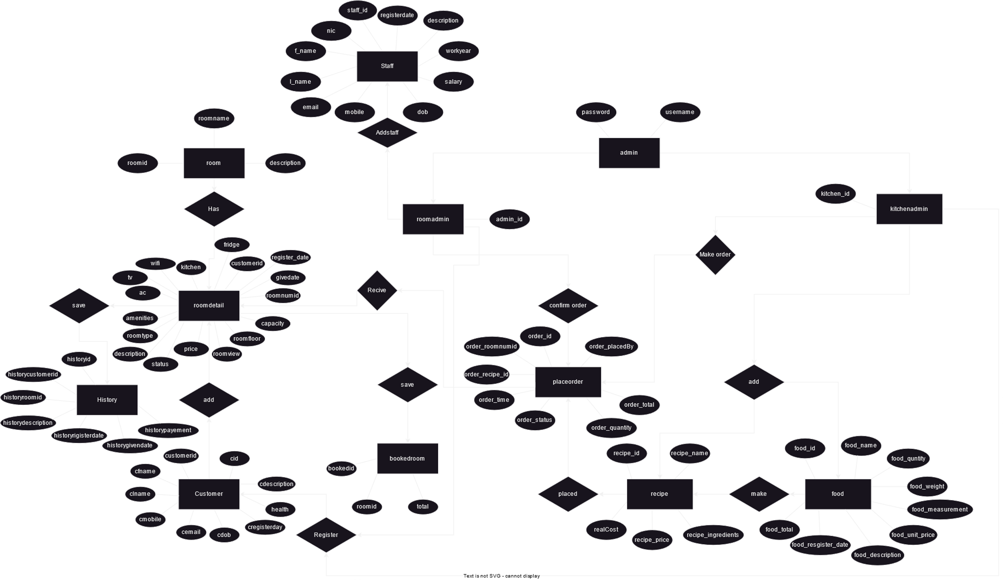
ER Diagram

Slide 12
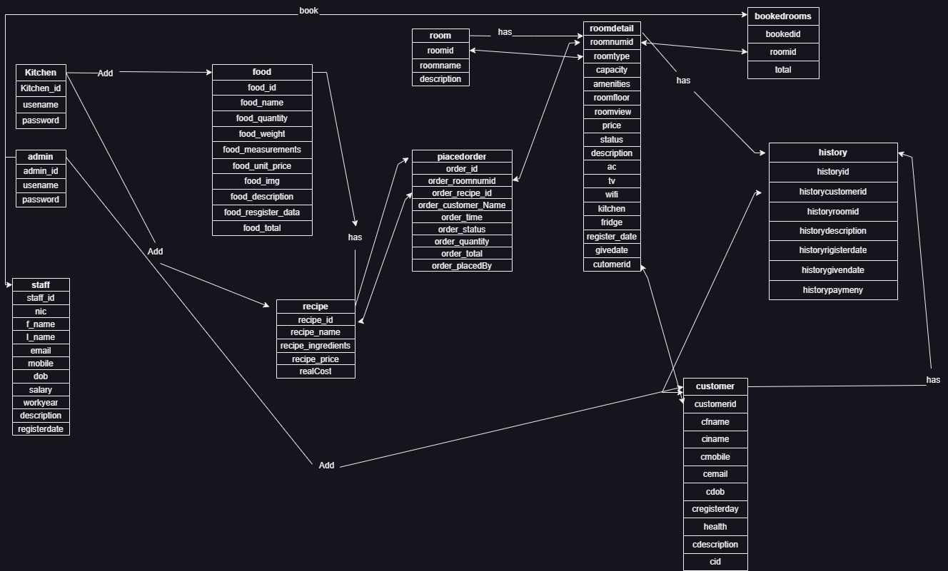
Class Diagram

Slide 13

Technologies
Database: MySQL
Backend Development: Use PHP as the programming language for the server-side development.
Frontend Development: JavaScript, HTML, and CSS Security:
user authentication mechanisms(Room admin ,kitchen admin).

Slide 14
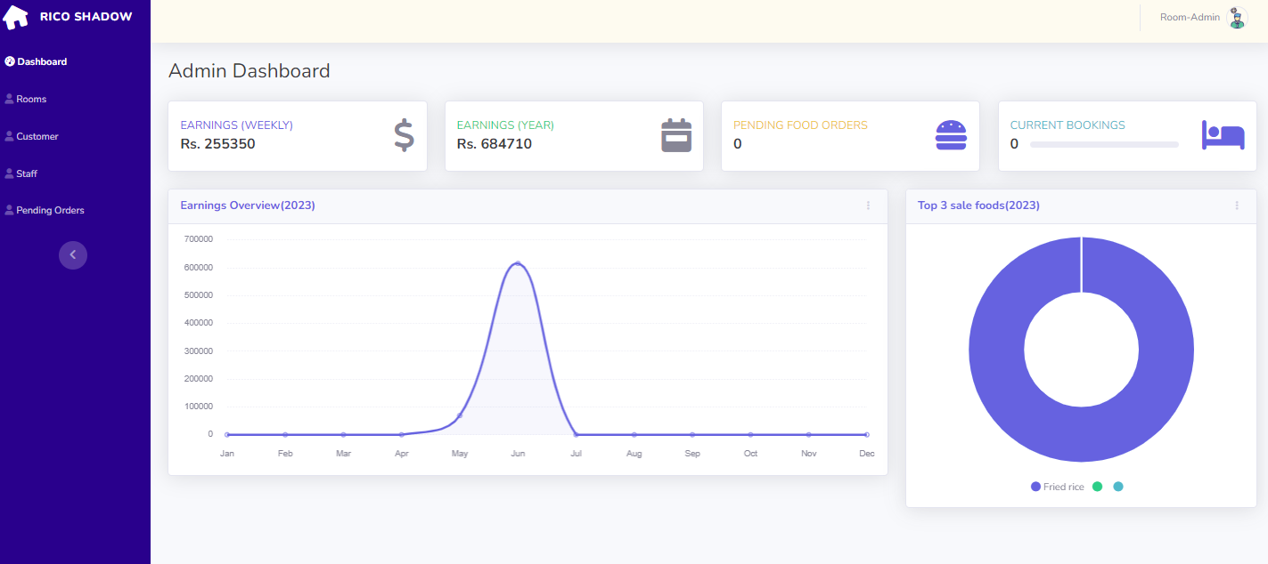
User Interface(Room Admin)
Admin dashboard

Slide 15
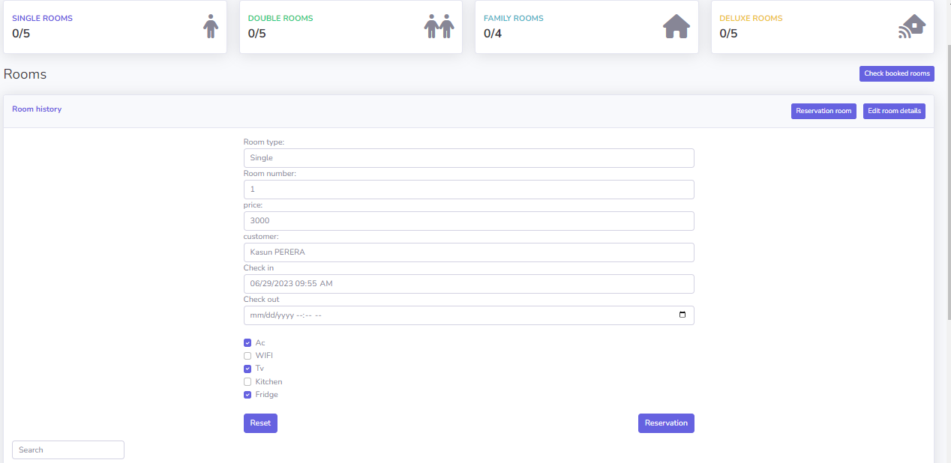
User Interface(Room Admin)
Room booking page

Slide 16
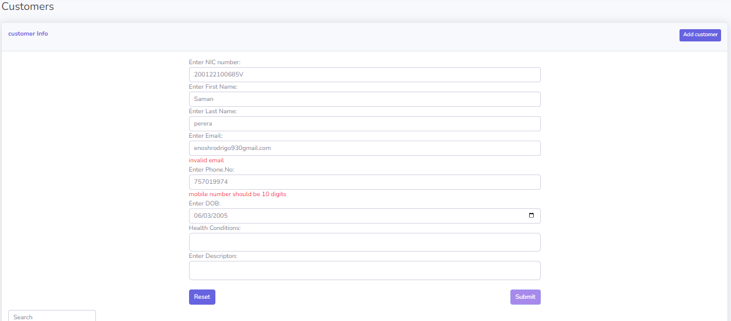
User Interface(Room Admin)
Add customer page

Slide 17
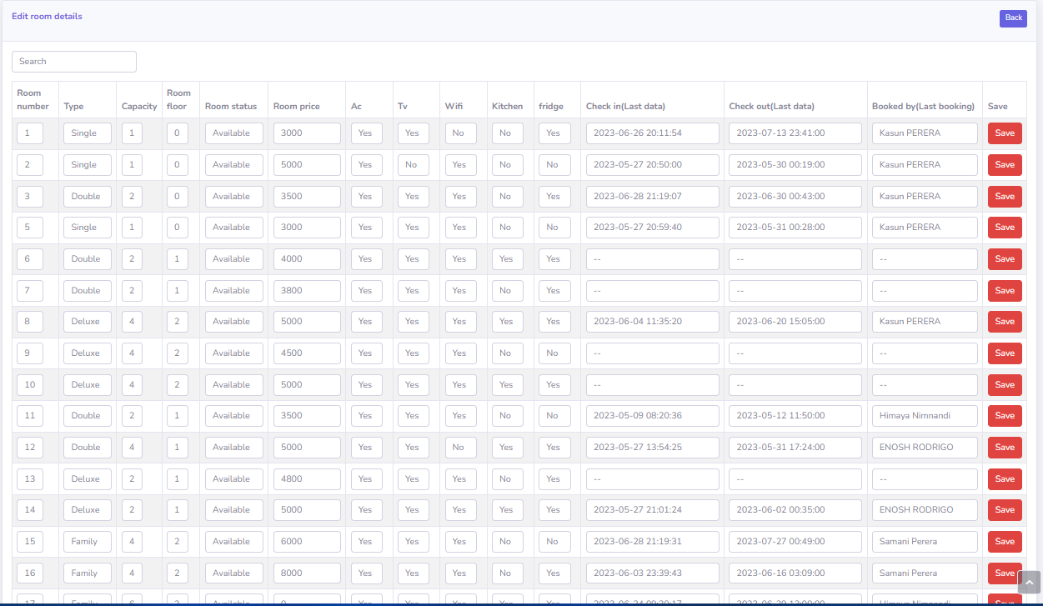
User Interface(Room Admin)
Edit room detail page

Slide 18
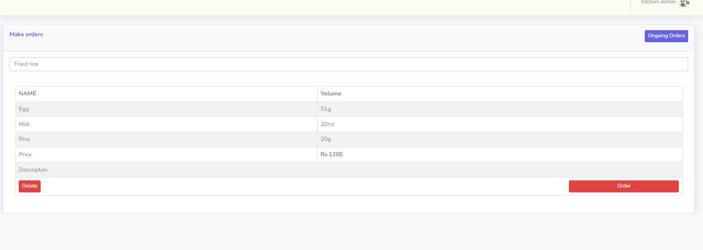
User Interface(Kitchen Admin)
Make orders page

Slide 19
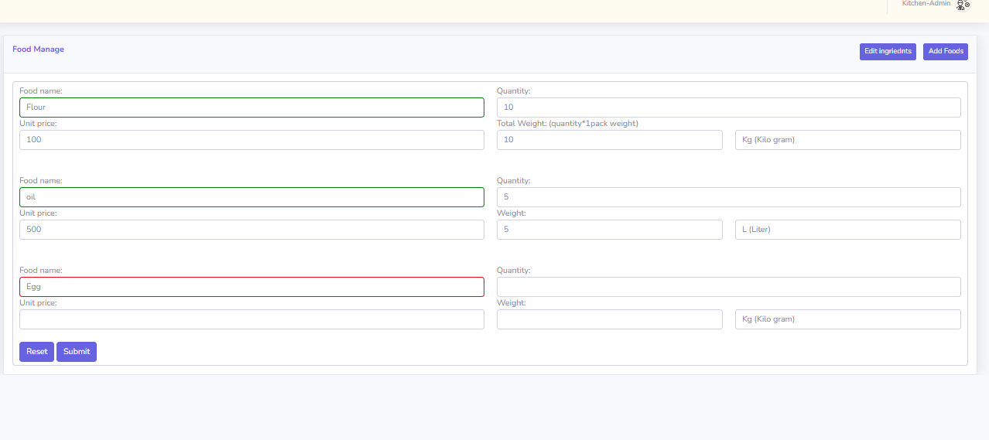
User Interface(Kitchen Admin)
Add ingredients page

Slide 20
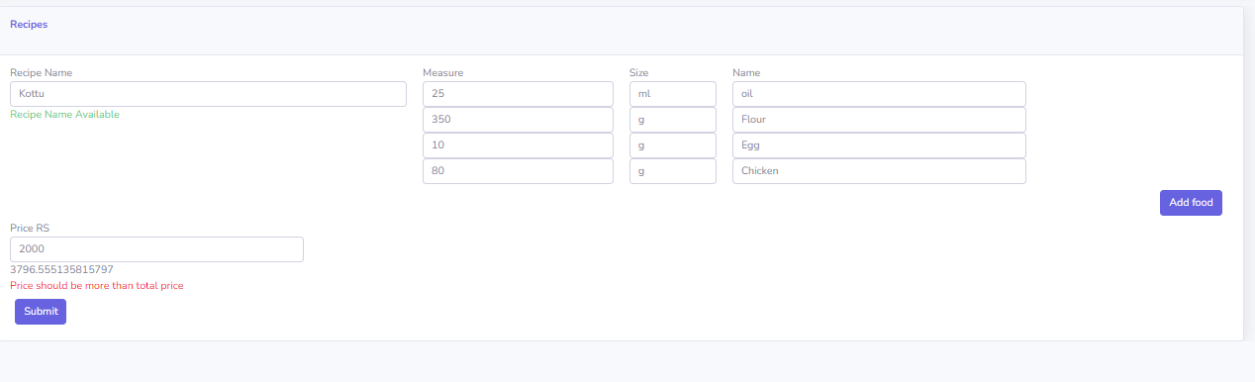
User Interface(Kitchen Admin)
Make recipe page

Slide 21
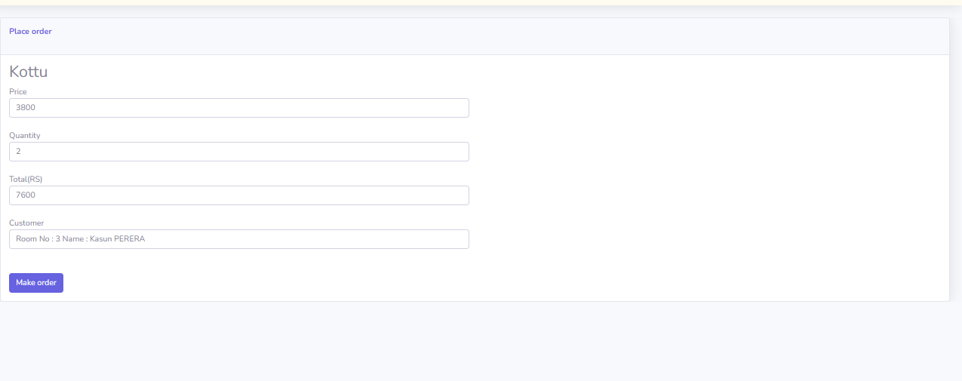
User Interface(Kitchen Admin)
Place food order for customers page

Slide 22
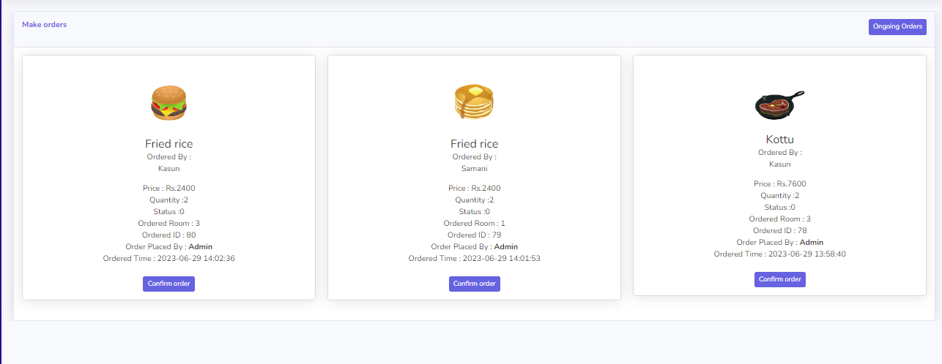
User Interface(Kitchen Admin)
Display ongoing orders page

Slide 23
User Interface(Kitchen Admin)
Display ongoing orders page
Thank you

